Slide 1
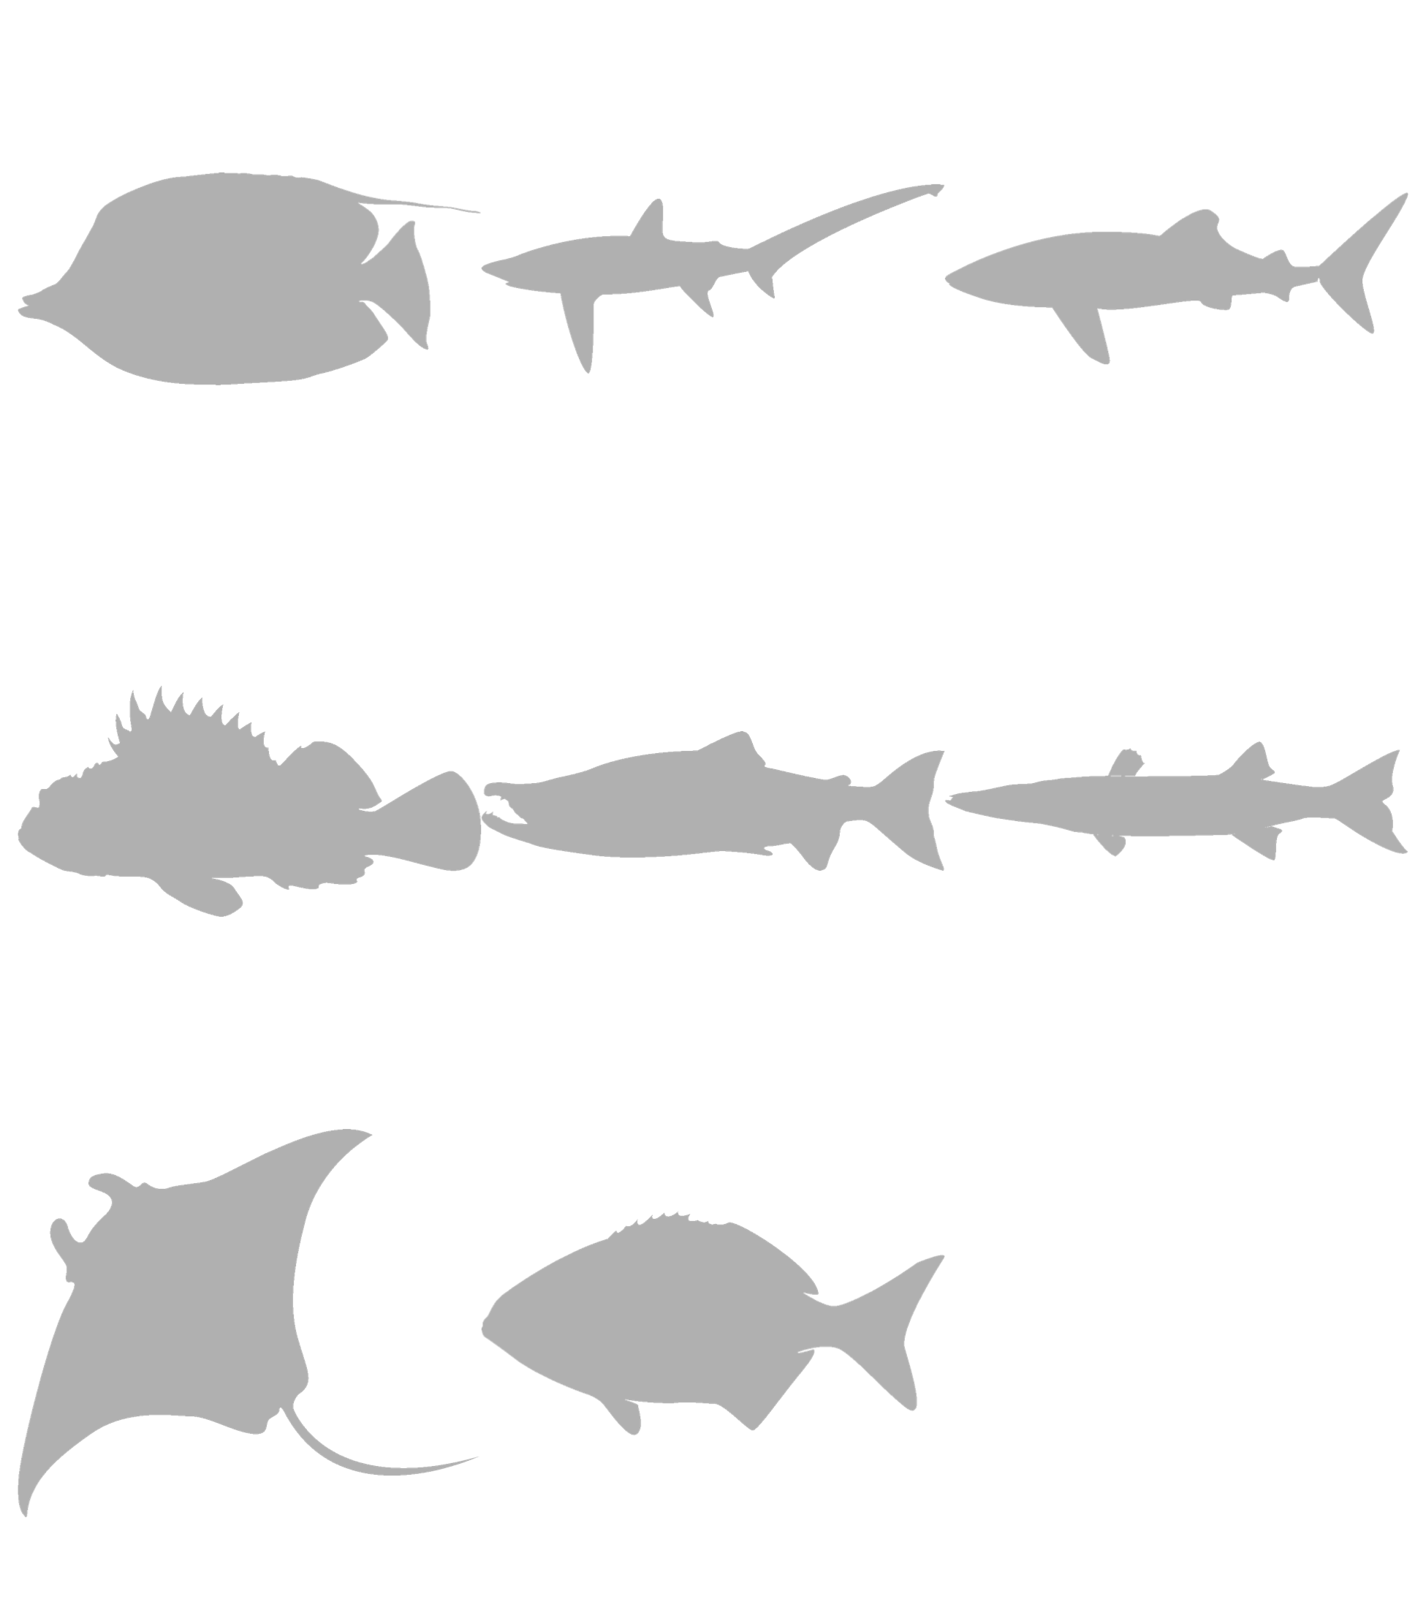
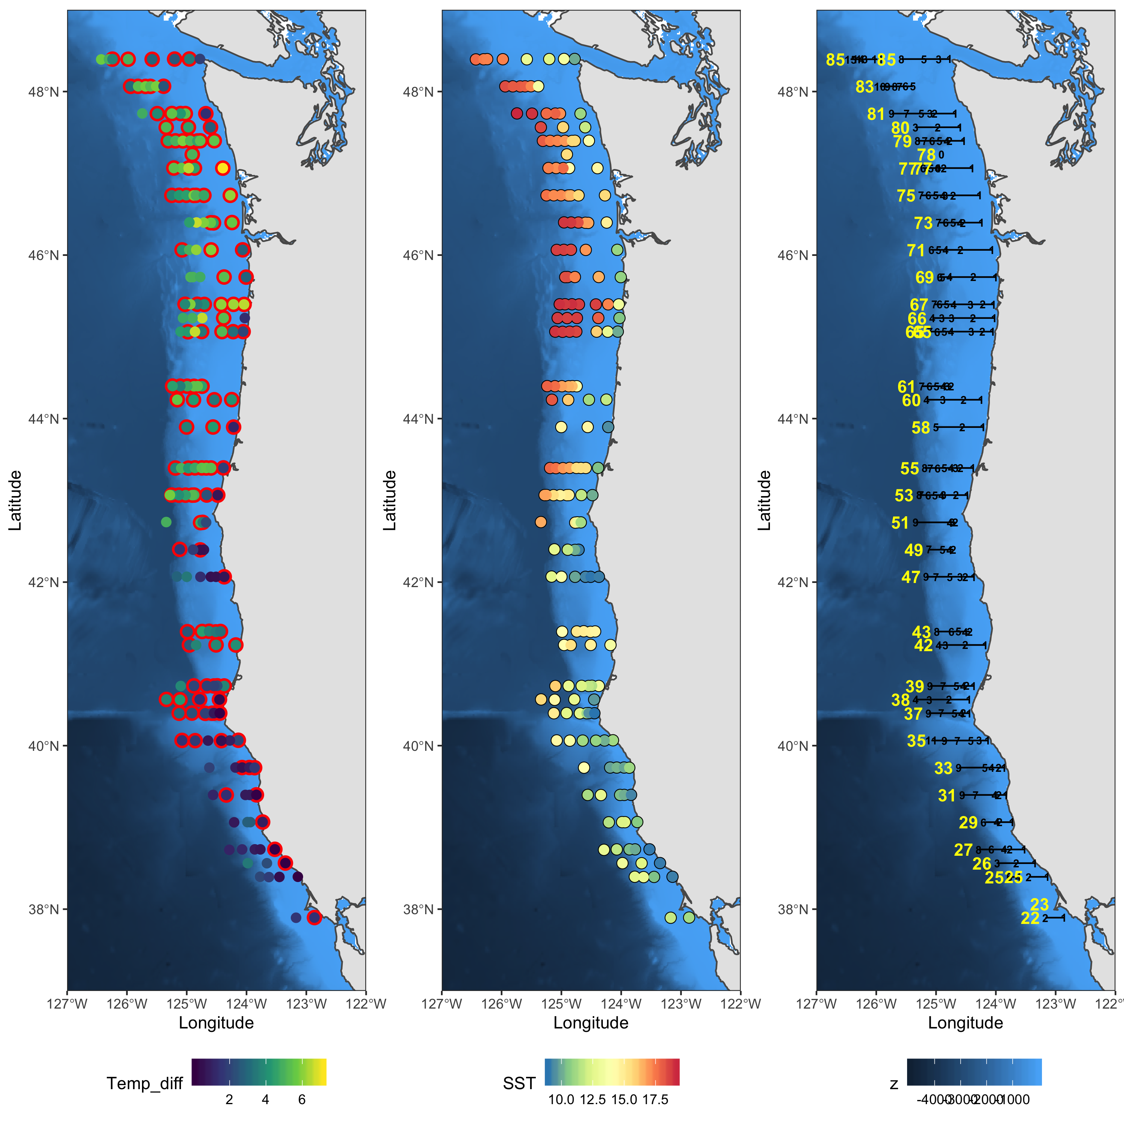
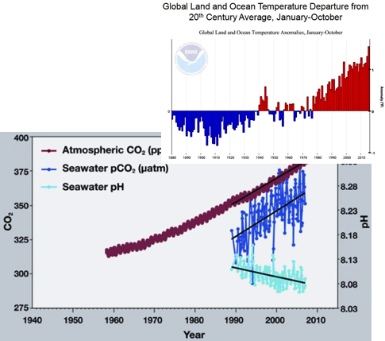

SPECIES DETECTION
STOCK ASSESMENT
ANADROMOUS
MARINE COMMUNITIES
Developing methods
Simulation and Statistics
ENVIRONMENTAL Change
DIET ANALYSIS
HABs
Bioinformatics

